Slide 1
Approximation Algorithms
Chapter 1- Introduction

Slide 2
Why Approximation Algorithms
Problems that we cannot find an optimal solution in a polynomial time
  Eg: Set Cover, Bin Packing
Need to find a near-optimal solution:
  Heuristic
  Approximation algorithms:
    This gives us a guarantee approximation ratio
My T. Thai
mythai@cise.ufl.edu

Slide 3
Introduction to Combinatorial Optimization
My T. Thai
mythai@cise.ufl.edu

Slide 4
Combinatorial Optimization
The study of finding the “best” object from within some finite space of objects, eg:
  Shortest path: Given a graph with edge costs and a pair of nodes, find the shortest path (least costs) between them
  Traveling salesman: Given a complete graph with nonnegative edge costs, find a minimum cost cycle visiting every vertex exactly once
  Maximum Network Lifetime: Given a wireless sensor networks and a set of targets, find a schedule of these sensors to maximize network lifetime
My T. Thai
mythai@cise.ufl.edu

Slide 5
In P or not in P?
Informal Definitions:
The class P consists of those problems that are solvable in polynomial time, i.e. O(n^{k}) for some constant k where n is the size of the input.
The class NP consists of those problems that are “verifiable” in polynomial time:
  Given a certificate of a solution, then we can verify that the certificate is correct in polynomial time
My T. Thai
mythai@cise.ufl.edu

Slide 6
In P or not in P: Examples
In P:
  Shortest path
  Minimum Spanning Tree
Not in P (NP):
  Vertex Cover
  Traveling salesman
  Minimum Connected Dominating Set
My T. Thai
mythai@cise.ufl.edu

Slide 7
NP-completeness (NPC)
A problem is in the class NPC if it is in NP and is as “hard” as any problem in NP
My T. Thai
mythai@cise.ufl.edu

Slide 8
What is “hard”
Decision Problems: Only consider YES-NO
  Decision version of TSP: Given n cities, is there a TSP tour of length at most L?
Why Decision Problem? What relation between the optimization problem and its decision?
  Decision is not “harder” than that of its optimization problem
  If the decision is “hard”, then the optimization problem should be “hard”
My T. Thai
mythai@cise.ufl.edu

Slide 9
NP-complete and NP-hard
A language L is NP-complete if:
L is in NP, and
For every L’ in NP, L’ can be polynomial-time reducible to L
My T. Thai
mythai@cise.ufl.edu

Slide 10
Approximation Algorithms
An algorithm that returns near-optimal solutions in polynomial time
Approximation Ratio ρ(n):
  Define: C* as a optimal solution and C is the solution produced by the approximation algorithm
  max (C/C*, C*/C) <= ρ(n)
  Maximization problem: 0 < C <= C*, thus C*/C shows that C* is larger than C by ρ(n)
  Minimization problem: 0 < C* <= C, thus C/C* shows that C is larger than C* by ρ(n)
My T. Thai
mythai@cise.ufl.edu

Slide 11
Approximation Algorithms (cont)
PTAS (Polynomial Time Approximation Scheme): A (1 + ε)-approximation algorithm for a NP-hard optimization П where its running time is bounded by a polynomial in the size of instance I
FPTAS (Fully PTAS): The same as above + time is bounded by a polynomial in both the size of instance I and 1/ε
My T. Thai
mythai@cise.ufl.edu

Slide 12
A Dilemma!
We cannot find C*, how can we compare C to C*?
How can we design an algorithm so that we can compare C to C*
It is the objective of this course!!!
My T. Thai
mythai@cise.ufl.edu

Slide 13
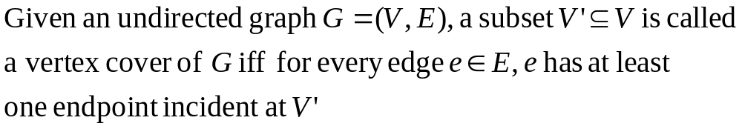
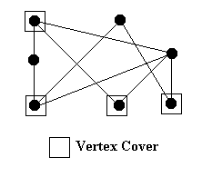
Vertex Cover
Definition:
An Example
My T. Thai
mythai@cise.ufl.edu

Slide 14
Vertex Cover Problem
Definition:
  Given an undirected graph G=(V,E), find a vertex cover with minimum size (has the least number of vertices)
  This is sometimes called cardinality vertex cover
More generalization:
  Given an undirected graph G=(V,E), and a cost function on vertices c: V → Q+
  Find a minimum cost vertex cover
My T. Thai
mythai@cise.ufl.edu

Slide 15
How to solve it
Matching:
  A set M of edges in a graph G is called a matching of G if no two edges in set M have an endpoint in common
Example:
My T. Thai
mythai@cise.ufl.edu

Slide 16
How to solve it (cont)
Maximum Matching:
  A matching of G with the greatest number of edges
Maximal Matching:
  A matching which is not contained in any larger matching
Note: Any maximum matching is certainly maximal, but not the reverse
My T. Thai
mythai@cise.ufl.edu

Slide 17
Main Observation
No vertex can cover two edges of a matching
The size of every vertex cover is at least the size of every matching: |M| ≤ |C|
|M| = |C| indicates the optimality
Possible Solution: Using Maximal matching to find Minimum vertex cover
My T. Thai
mythai@cise.ufl.edu

Slide 18
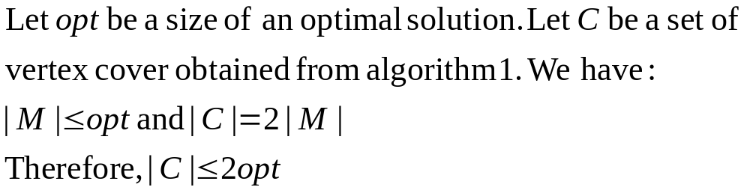
An Algorithm
Alg 1: Find a maximal matching in G and output the set of matched vertices
Theorem: The algorithm 1 is a factor 2-approximation algorithm.
Proof:
My T. Thai
mythai@cise.ufl.edu

Slide 19
Can Alg1 be improved?
Q1: Can the approximation ratio of Alg 1 be improved by a better analysis?
Q2: Can we design a better approximation algorithm using the similar technique (maximal matching)?
Q3: Is there any other lower bounding method that can lead to a better approximation algorithm?
My T. Thai
mythai@cise.ufl.edu

Slide 20
Answers
A1: No by considering the complete bipartite graphs K_{n,n}
A2: No by considering the complete graph K_{n} where n is odd.
  |M| = (n-1)/2 whereas opt = n -1
My T. Thai
mythai@cise.ufl.edu

Slide 21
Answers (cont)
A3:
  Currently a central open problem
  Yes, we can obtain a better one by using the semidefinite programming
Generalization vertex Cover
  Can we still able to design a 2-approximation algorithm?
  Homework assignment!
My T. Thai
mythai@cise.ufl.edu

Slide 22
Set Cover
Definition: Given a universe U of n elements, a collection of subsets of U, S = {S₁, …, S_{m}}, and a cost function c: S → Q+, find a minimum cost subcollection C of S that covers all elements of U.
Example:
  U = {1, 2, 3, 4, 5}
  S₁ = {1, 2, 3}, S₂ = {2,3}, S₃ = {4, 5}, S₄ = {1, 2, 4}
  c₁ = c₂ = c₃ = c₄ = 1
  Solution C = {S₁, S₃}
If the cost is uniform, then the set cover problem asks us to find a subcollection covering all elements of U with the minimum size.
My T. Thai
mythai@cise.ufl.edu

Slide 23
An Example
My T. Thai
mythai@cise.ufl.edu

Slide 24
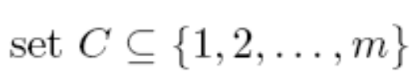


NP-completeness
Theorem: Set Cover (SC) is NP-complete
Proof:
INSTANCE: Given a universe U of n elements, a collection of subsets of U, S = {S₁, …, S_{m}}, and a positive integer b
QUESTION: Is there a , |C| ≤ b, such that
(Note: The subcollection {S_{i} | } satisfying the above condition is called a set cover of U
My T. Thai
mythai@cise.ufl.edu

Slide 25
Proof (cont)
First we need to show that SC is in NP. Given a collection of sets C, it is easy to verify that if |C| ≤ b and the union of all sets listed in C does include all elements in U.
To complete the proof, we need to show that Vertex Cover (VC) ≤_{p} Set Cover (SC)
Given an instance C of VC (an undirected graph G=(V,E) and a positive integer j), we need to construct an instance C’ of SC in polynomial time such that C is satisfiable iff C’ is satisfiable.
My T. Thai
mythai@cise.ufl.edu

Slide 26
Proof (cont)
Construction: Let U = E. We will define n elements of U and a collection S as follows:
Note: Each edge corresponds to each element in U and each vertex corresponds to each set in S.
  Label all vertices in V from 1 to n. Let S_{i} be the set of all edges that incident to vertex i. Finally, let b = j. This construction is in poly-time with respect to the size of VC instance.
My T. Thai
mythai@cise.ufl.edu

Slide 27
VERTEX-COVER ≤_{p} SET-COVER
one element for every edge
VC
VC
SC
one set for every vertex, containing the edges it covers
My T. Thai
mythai@cise.ufl.edu

Slide 28
Proof (cont)
Now, we need to prove that C is satisfiable iff C’ is.
That is, we need to show that if the original instance
of VC is a yes instance iff the constructed instance of
SC is a yes instance.
(→) Suppose G has a vertex cover of size at most j, called C. By our construction, C corresponds to a collection C’ of subsets of U. Since b = j, |C’| ≤ b. Plus, C’ covers all elements in U since C “covers” all edges in G. To see this, consider any element of U. Such an element is an edge in G. Since C is a set cover, at least endpoint of this edge is in C.
My T. Thai
mythai@cise.ufl.edu

Slide 29
(←) Suppose there is a set cover C’ of size at most b in our constructed instance. Since each set in C’ is associated with a vertex in G, let C be the set of these vertices. Then |C| = |C’| ≤ b = j. Plus, C is a vertex cover of G since C’ is a set cover. To see this, consider any edge e. Since e is in U, C’ must contain at least one set that includes e. By our construction, the only set that include e correspond to nodes that are endpoints of e. Thus C must contain at least one endpoints of e.
My T. Thai
mythai@cise.ufl.edu

Slide 30
Solutions
Algorithm 1: (in the case of uniform cost)
1: C = empty
2: while U is not empty
3: pick a set S_{i} such that S_{i} covers the most elements in U
4: remove the new covered elements from U
5: C = C union S_{i}
6: return C
My T. Thai
mythai@cise.ufl.edu

Slide 31
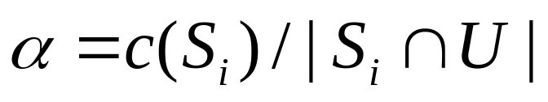
Solutions (cont)
In the case of non-uniform cost
Similar method. At each iteration, instead of picking a set S_{i} such that S_{i} covers the most uncovered elements, we will pick a set S_{i} whose cost-effectiveness α is smallest, where α is defined as:
Questions: Why choose smallest α? Why define α as above
My T. Thai
mythai@cise.ufl.edu

Slide 32
Solutions (cont)
Algorithm 2: (in the case of non-uniform cost)
1: C = empty
2: while U is not empty
3: pick a set S_{i} such that S_{i} has the smallest α
4: for each new covered elements e in U
5: set price(e) = α
6: remove the new covered elements from U
7: C = C union S_{i}
8: return C
My T. Thai
mythai@cise.ufl.edu

Slide 33
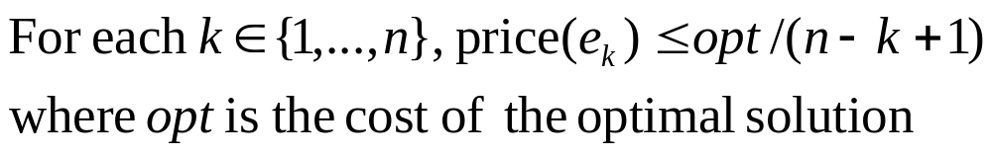
Approximation Ratio Analysis
Let e_{k}, k = 1…n, be the elements of U in the order in which they were covered by Alg 2. We have:
Lemma 1:
Proof: Let U_{j} be the set the remaining set U at iteration j. That is, U_{j} contains all the uncovered elements at iteration j. At any iteration j, the leftover sets of the optimal solution can cover the remaining elements at a cost of at most opt. (Why?)
My T. Thai
mythai@cise.ufl.edu

Slide 34
Proof of Lemma 1 (cont)
Thus, among these leftover sets, there must exist one set where its α value is at most opt/|U_{j}|. Let e_{k} be the element covered at this iteration, |Uj| ≥ n – k + 1. Since e_{k} was covered by the most cost-effective set in this iteration, we have:
price(e_{k}) ≤ opt/|U_{j}| ≤ opt/(n-k+1)
My T. Thai
mythai@cise.ufl.edu

Slide 35
Approximation Ratio
Theorem 1: The set cover obtained form Alg 2 (also Alg 1) has a factor of H_{n} where H_{n} is a harmonic series H_{n} = 1 + 1/2 + … + 1/n
Proof: It follows directly from Lemma 1
My T. Thai
mythai@cise.ufl.edu

